Slide 1
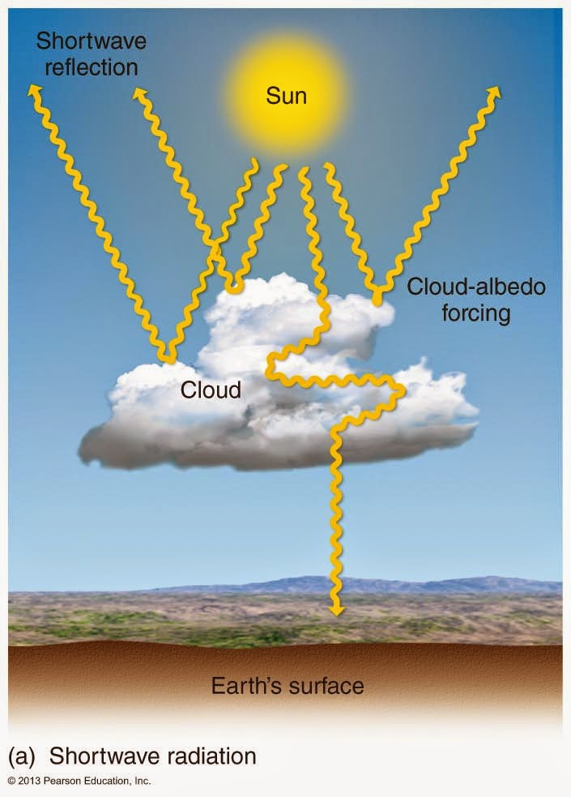
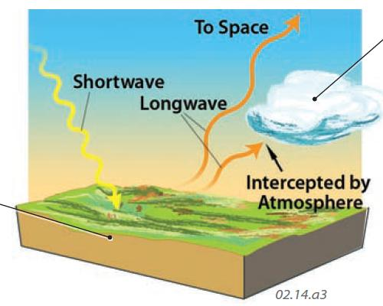
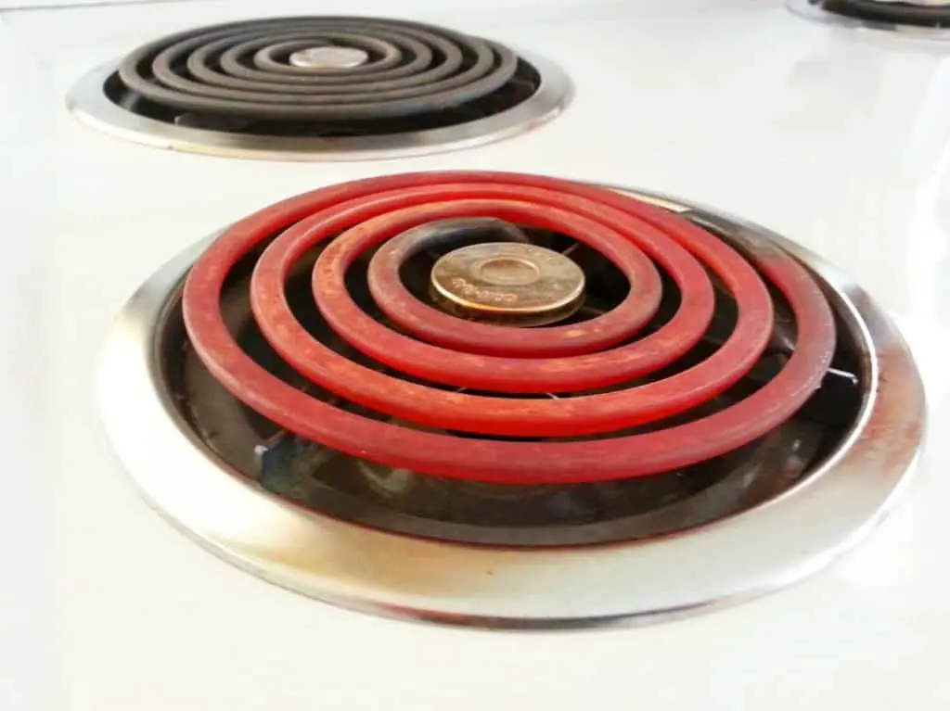
Recap: SW flux, albedo, LW flux, and radiative balance
Energy comes to the earth in the form of shortwave (SW) radiation from the sun, of which a good chunk is visible light. About 30% is reflected away – we say the albedo is 0.3 – without heating anything. The remaining 70% is responsible for heating the planet.
Energy leaves the earth as longwave (LW) radiation emitted by the earth itself. The LW emitted by Earth is invisible to human eyes, but you’re familiar with the basic idea, because you’ve seen glowing coils on a stove top.
When SW and LW energy fluxes are exactly the same, we say Earth is in radiative balance.

Slide 2
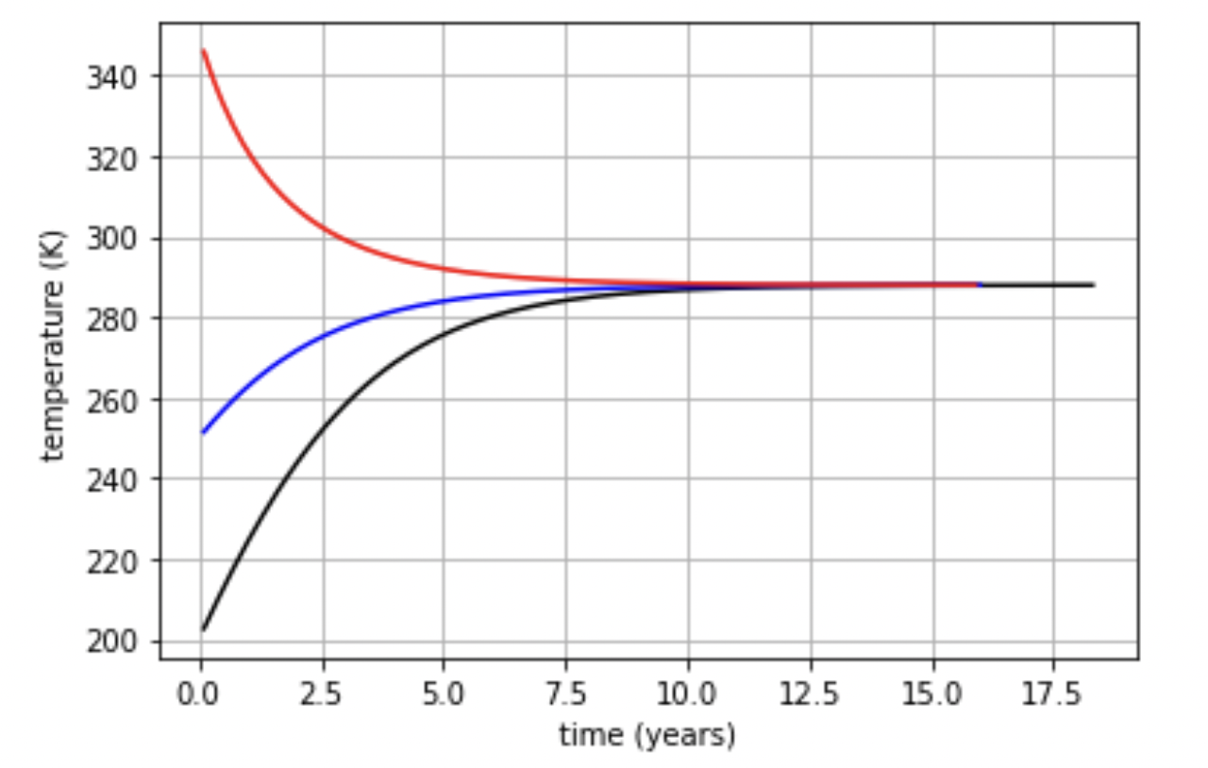
This is kinda what we expect of a system that experiences homeostasis
To simulate this in Python, we’ll need to have a way to march through time (left to right in this graph), calculate a flux at each step, and adjust Earth’s temperature accordingly. For that we’ll need the looping stuff we learned earlier this week.
We’ll also need a little more math.

Slide 3

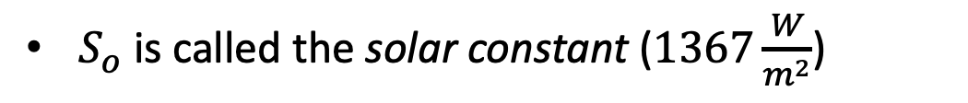

To get there in python, we’ll need to calculate the incoming SW, which we’ll call ASR
$S_{o}$ is called the solar constant ($1367\frac{W}{m^{2}}$)
$$S_{o}$$

Slide 4
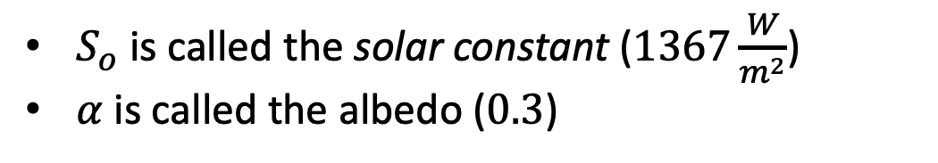

To get there in python, we’ll need to calculate the incoming SW, which we’ll call ASR
$S_{o}$ is called the solar constant ($1367\frac{W}{m^{2}}$)
$α$ is called the albedo ($0.3$)
$$α$$
$$S_{o}$$

Slide 5

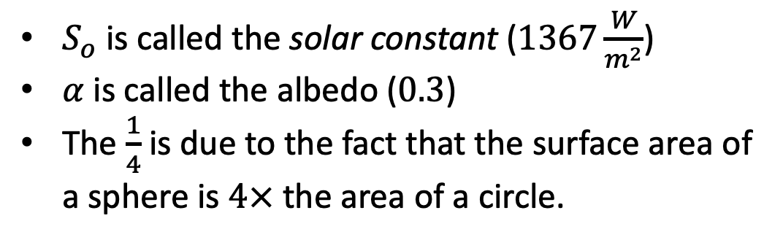
To get there in python, we’ll need to calculate the incoming SW, which we’ll call ASR
$S_{o}$ is called the solar constant ($1367\frac{W}{m^{2}}$)
$α$ is called the albedo ($0.3$)
The $\frac{1}{4}$ is due to the fact that the surface area of a sphere is $4×$ the area of a circle.
$$α$$
$$S_{o}$$

Slide 6

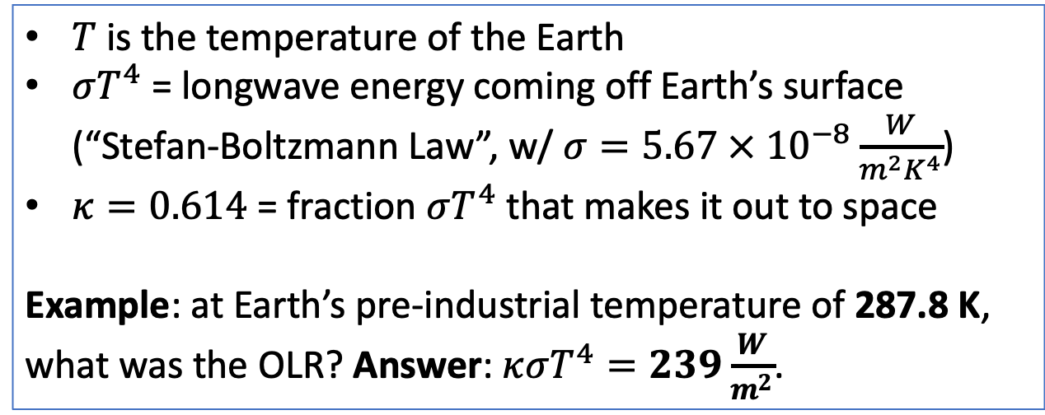

We’ll also need the outgoing LW, which we’ll call OLR
$T$ is the temperature of the Earth
$σT^{4}$ = longwave energy coming off Earth’s surface (“Stefan-Boltzmann Law”, w/ $σ=5.67 × {10}^{−8}\frac{W}{m^{2}K^{4}}$)
$κ=0.614$ = fraction $σT^{4}$ that makes it out to space
Example: at Earth’s pre-industrial temperature of 287.8 K, what was the OLR? Answer: $κσT^{4}=239\frac{W}{m^{2}}$.
The Stefan-Boltzmann law quantifies what you already know: a hot object emits more radiant heat than a cold object does.
$$T$$

Slide 7

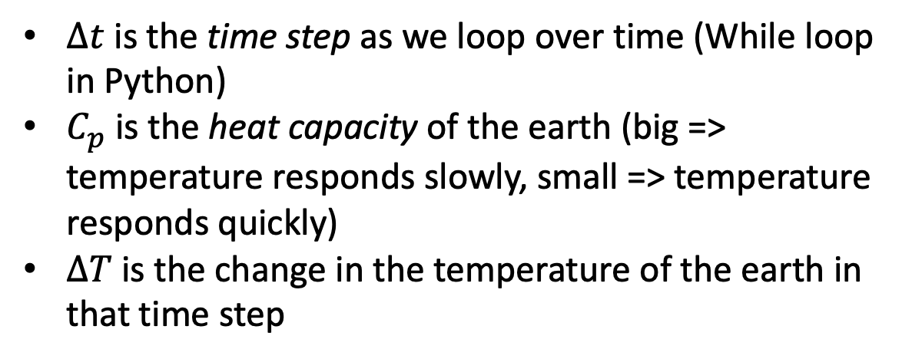
At any given time, the difference between ASR and OLR will result in a temperature change
$∆t$ is the time step as we loop over time (While loop in Python)
$C_{p}$ is the heat capacity of the earth (big => temperature responds slowly, small => temperature responds quickly)
$∆T$ is the change in the temperature of the earth in that time step

Slide 8
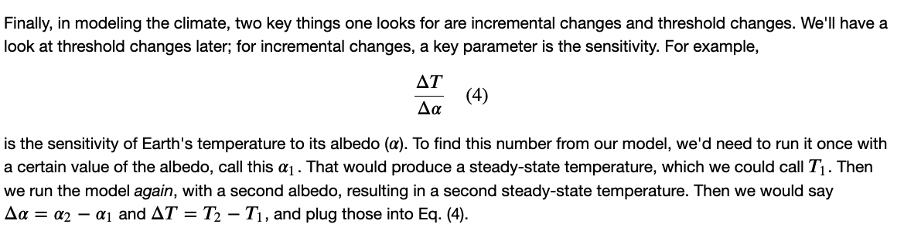
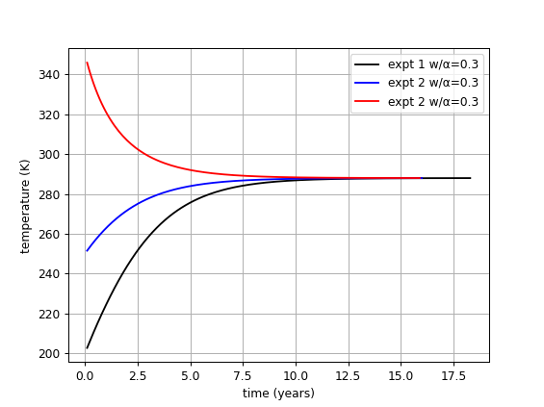
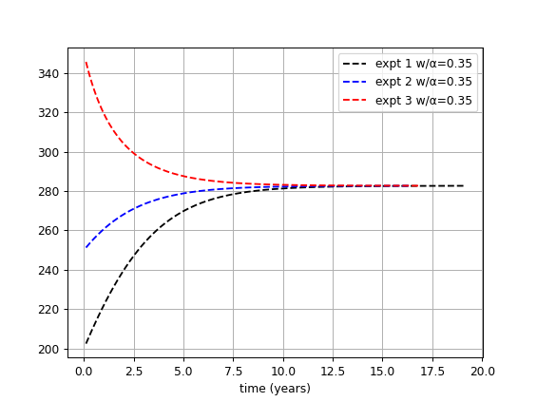
There’s also the climate sensitivity to forcing due to changes in Earth’s albedo

Slide 9
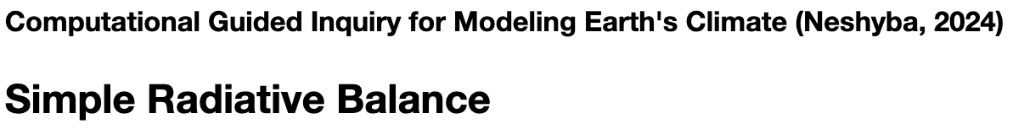
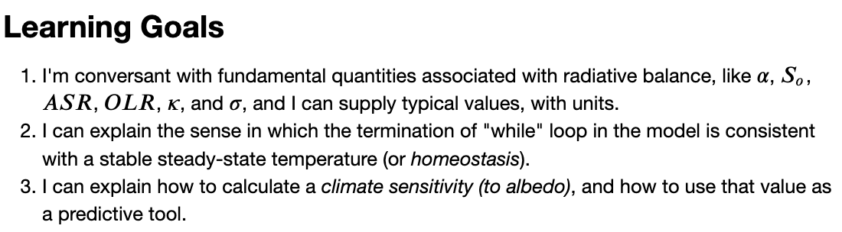
OK, let’s get started

Slide 10
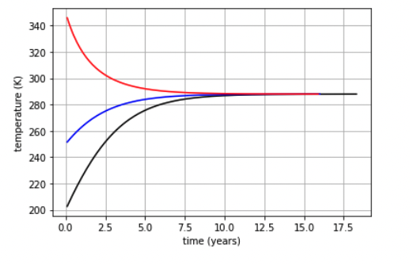
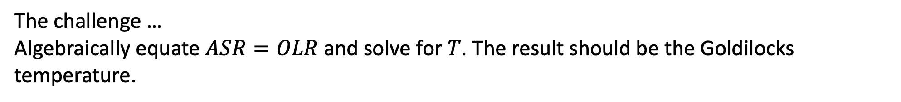
If you finish early, you can try the challenge
The challenge …
Algebraically equate $ASR=OLR$ and solve for $T$. The result should be the Goldilocks temperature.
Goldilocks temperature (when ASR = OLR)

